Slide 1
Pepper Programming
Dr. Samuele Vinanzi
Robotics and Artificial Intelligence
Sheffield Hallam University

Slide 2
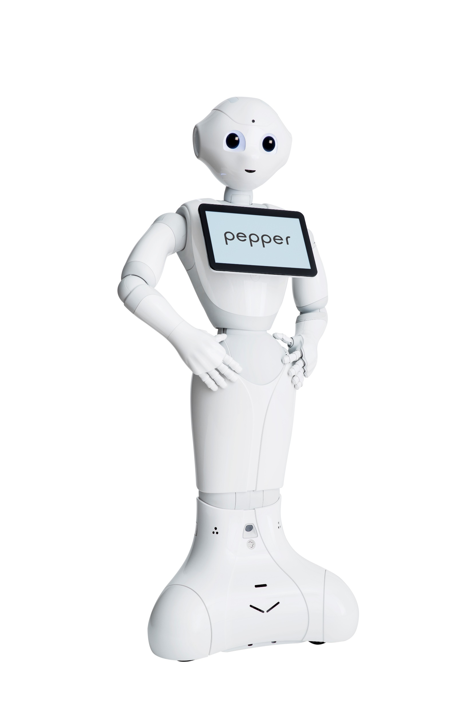
SOFTBANK PEPPER ROBOT
Manufactured in 2014 by SoftBank (formerly Aldebaran), a Japanese company.
«Pepper is intended to make people enjoy life, enhance people's lives, facilitate relationships, entertain and connect people with the outside world»
PROCESSOR | Atom E3845
CPU | Quad core
Clock speed | 1.91 GHz
RAM | 4 GB DDR3
GPU | Intel HD graphics 792 MHz

Slide 3
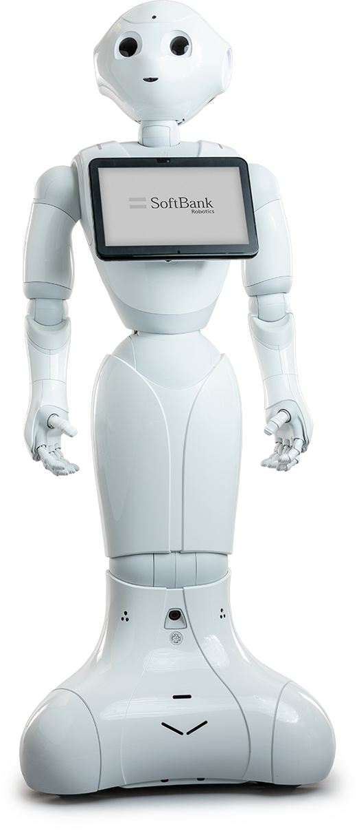
SOFTBANK PEPPER ROBOT
RGB cameras
Tactile sensors
Microphones
Depth cameras
Speakers
Gyroscope
Tablet
Inertial sensors
Tactile sensors
Lasers
Sonars
Bumpers
Omnidirectional wheels

Slide 4
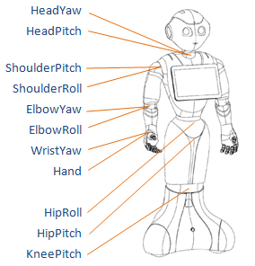
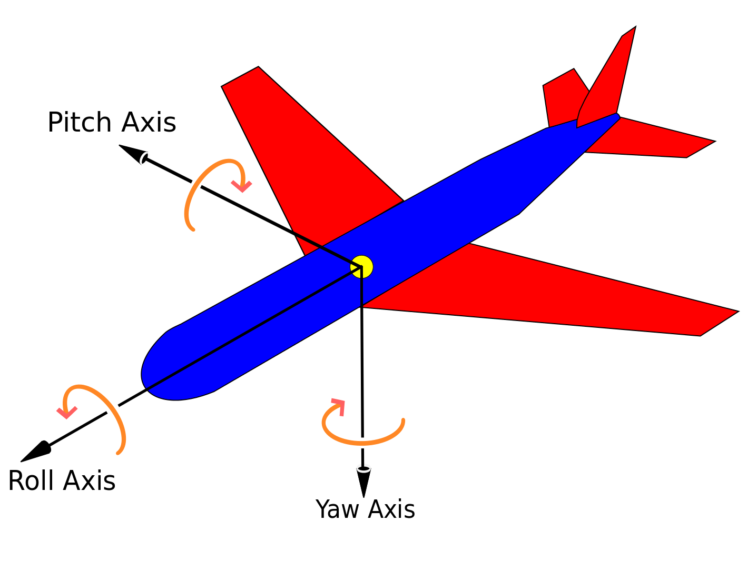
SOFTBANK PEPPER ROBOT
3D rotational axes (roll, pitch yaw)

Slide 5

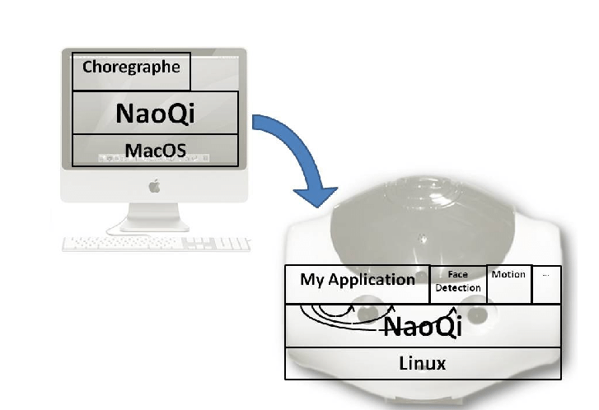
Middleware: naoqi
Proprietary software of SoftBank Robotics.
Used across their robots: Nao and Pepper.
Interfaces in Python and C++.

Slide 6
PROGRAMMING PEPPER
ROS
Choregraphe
Python
C++

Slide 7

CHoregraphe
Easiest way of programming the robot.
No code: only graphical blocks that are combined to form behaviors.
Useful for:
  Learning robot programming
  Developing simple behaviors
  Simulation
  Monitoring the robot
  Designing animations
  http://doc.aldebaran.com/2-5/software/choregraphe/tutos/index.html

Slide 8
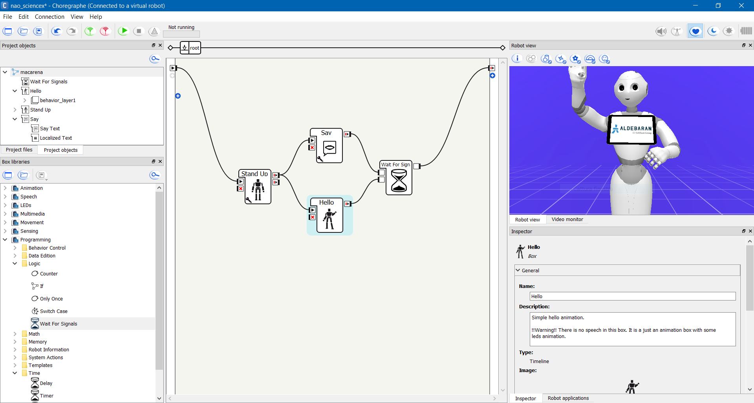
Choregraphe OVERVIEW

Slide 9
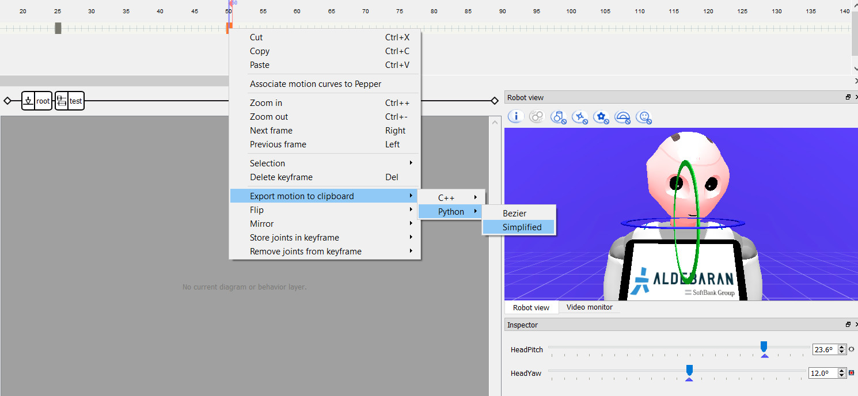
CHOREGRAPHE OVERVIEW

Slide 10
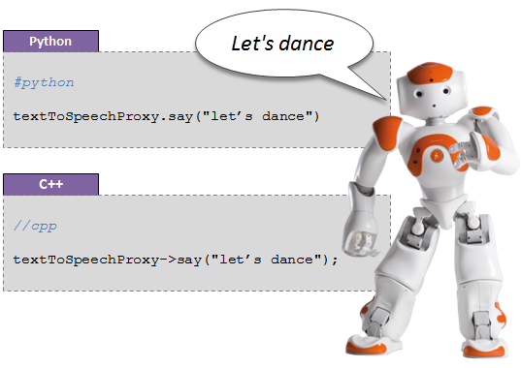
PYTHON PROGRAMMING
NAOqi is the name of the main software that runs on the robot and controls it.
Interfaces in Python and C++.
http://doc.aldebaran.com/2-5/dev/naoqi/index.html

Slide 11
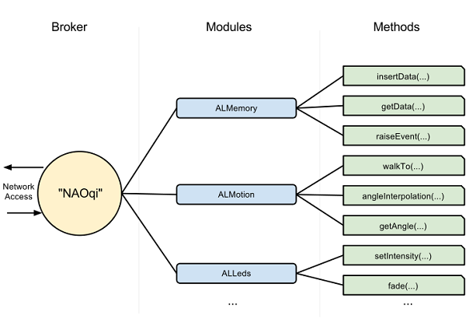
PYTHON programming

Slide 12
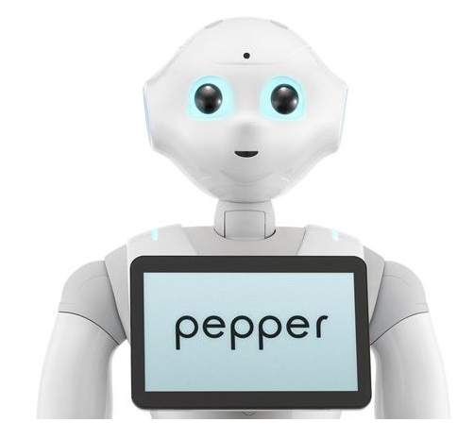
PYTHON PROGRAMMING
from naoqi import ALProxy
IP = "pepper.local"
PORT = 9559
tts = ALProxy("ALTextToSpeech", IP, PORT)
tts.setLanguage("English")
tts.say("Hello, world!")
Hello, world!

Slide 13
PYTHON PROGRAMMING
Talks after walking
from naoqi import ALProxy
IP = "pepper.local"
PORT = 9559
motion = ALProxy("ALMotion", IP, PORT)
tts = ALProxy("ALTextToSpeech", IP, PORT)
motion.moveInit()
motion.moveTo(0.5, 0, 0) # (x; y; theta)
tts.say("I am walking")
from naoqi import ALProxy
IP = "pepper.local"
PORT = 9559
motion = ALProxy("ALMotion", IP, PORT)
tts = ALProxy("ALTextToSpeech", IP, PORT)
motion.moveInit()
id = motion.post.moveTo(0.5, 0, 0) # (x; y; theta)
motion.wait(id, 0)
tts.say("I have walked")
Talks while walking

Slide 14
Python programming
Useful modules to keep in mind (check documentation for full API description):
ALVideoDevice
ALTextToSpeech
ALAnimatedSpeech
ALMotion
ALFaceTracker
ALLeds
ALLandmarkDetection
ALMemory
ALSpeechRecognition
API documentation: http://doc.aldebaran.com/2-5/naoqi/index.html

